Slide 1
Unsupervised Learning
DS Training 101
SME: Daniel Seal
Creators: Anthony Eze-Onuorah and Daniel Seal

Slide 2
Agenda
Expectations
Clustering
Code & Learn or Listen & Learn:
A click-through Jupyter Notebook (.ipynb) is provided here. The notebook is bookmarked according to the .PPT slides and will remain in the repository for those who wish to clone and revisit it. The aim of the code is to provide a comprehensive explanation and practical demonstration of everything we discuss in the session.
A recording of this session will also be available.
K-Means(n_clusters)
DBSCAN(Epsilon, MinPts)
Clustering Performance Metrics
Live Coding

Slide 3
AIMS
Be more familiar with 2 common unsupervised learning (clustering) algorithms, both theoretically and practically.
Be aware that unsupervised learning is unsupervised. There typically isn’t a silver bullet like supervised problems, especially when it comes to unlabelled data.
Be more confident at exploring data using unsupervised learning and embedding such techniques into a DS solution.

Slide 4
Clustering

Slide 5
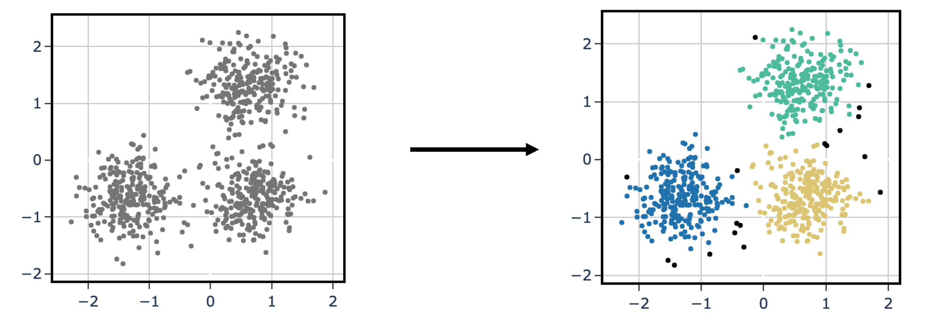
What is Unsupervised Learning?
“Unsupervised learning is a type of algorithm that learns patterns from untagged data”
Clustering is an unsupervised learning technique whereby an algorithm automatically groups its training examples into categories with similar features. A cluster is therefore a collection of objects which are “similar” between themselves and “dissimilar” to the objects belonging to other clusters.

Slide 6
K-Means

Slide 7
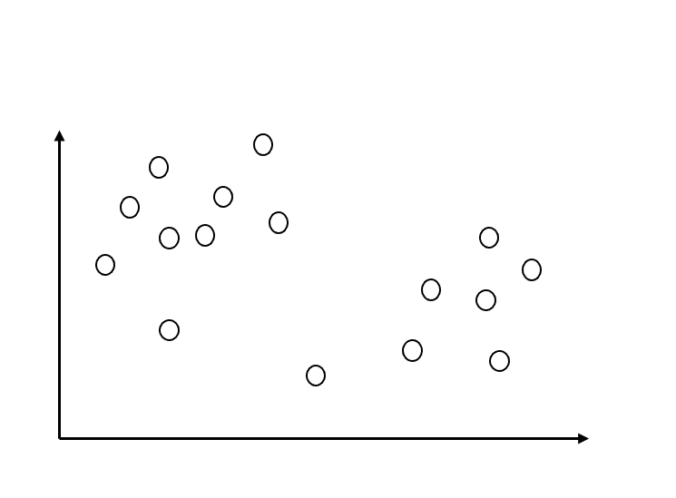
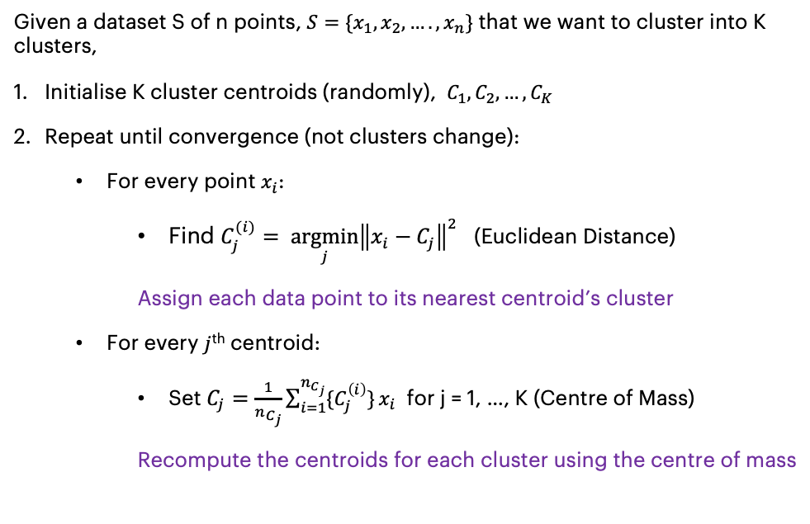
K-Means(n_clusters)
Objective
Cluster the data into K clusters by minimising the sum of distances between the points and their respective cluster centroids such that points within the same cluster are as similar to each other as possible
Method
Given a dataset S of n points, $S=\{x_{1},x_{2}, ….,x_{n}\}$ that we want to cluster into K clusters,
Initialise K cluster centroids (randomly), $C_{1}, C_{2}, …, C_{K}$
Repeat until convergence (not clusters change):
For every point $x_{i}$:
Find $C_{j}^{(i)}= {\underset{j}{argmin}\left\|x_{i}−C_{j}\right\|}^{2}$ (Euclidean Distance)
Assign each data point to its nearest centroid’s cluster
For every $j$^{th} centroid:
Set $C_{j}=\frac{1}{n_{C_{j}}}\sum_{i=1}^{n_{C_{j}}}{\{C_{j}^{\left(i\right)}\}}x_{i}$ for j = 1, …, K (Centre of Mass)
Recompute the centroids for each cluster using the centre of mass
Notes:
Intro – ​
K MEANS – to start in layman terms, break it down into two parts ​
- 'k' represents the number of clusters we are looking to form (point at the diagram)​
- 'MEANS' refers to the mean of each cluster, or the centroid (point at the +, x and O)​
​
Objective - ​
Group the points together such that (a) the ones in the same cluster are as similar to each other as possible,​
And (b) the points in one cluster are as distinct as possible from the points in other clusters​
Now, to measure similarity - we look at the variance within each cluster. How much does each data point deviate from the cluster mean? ​
Essentially we sum up that deviation for all data points in a cluster and try to minimise this sum of distances between the points and the cluster centroid. The lower the variation, more similar are the points. ​
​
Parameters – Euclidean distance
- V unlikely that the initial centroid is in the center (bec it’s randomly assigned) so we need to recompute the centre. Talk about orange points (6 and 4)
​
Segue > look at the diagram – shows different iterations and how the division keeps changing until it stabilises ​

Slide 8
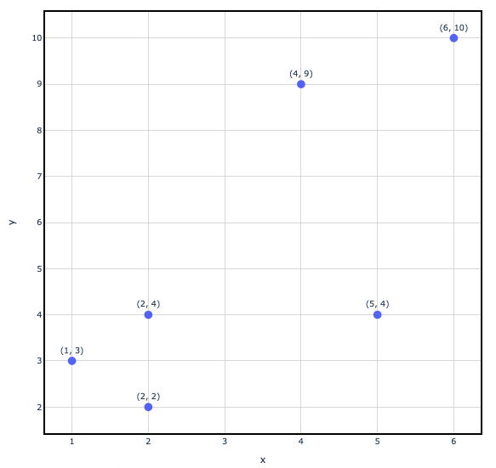
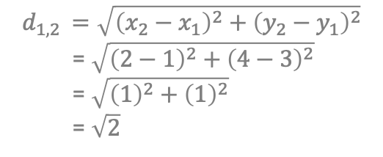
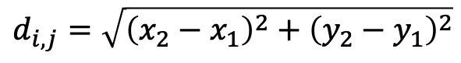
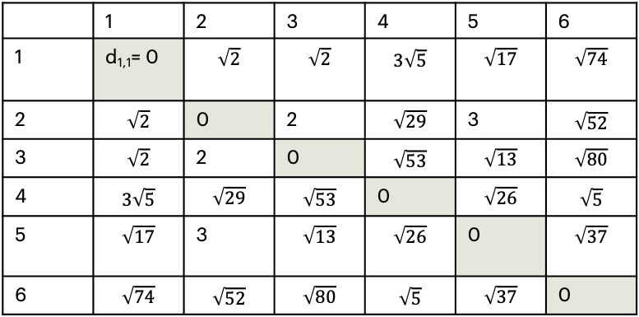
Euclidean Distance
“The Euclidean distance between two points in Euclidean space is the length of a line segment between the two points.”
6
$$d_{i, j}=\sqrt{{\left(x_{2}−x_{1}\right)}^{2}+{\left(y_{2}−y_{1}\right)}^{2}}$$
4
$$d_{1,2 }=\sqrt{{\left(x_{2}−x_{1}\right)}^{2}+{\left(y_{2}−y_{1}\right)}^{2}}$$
= $\sqrt{{\left(2−1\right)}^{2}+{\left(4−3\right)}^{2}}$
= $\sqrt{{\left(1\right)}^{2}+{\left(1\right)}^{2}}$
= $\sqrt{2}$
d_{1,4}
d_{1,6}
 | 1 | 2 | 3 | 4 | 5 | 6
1 | d_{1,1}= 0 | $$\sqrt{2}$$ | $$\sqrt{2}$$ | $$3\sqrt{5}$$ | $$\sqrt{17}$$ | $$\sqrt{74}$$
2 | $$\sqrt{2}$$ | 0 | 2 | $$\sqrt{29}$$ | 3 | $$\sqrt{52}$$
3 | $$\sqrt{2}$$ | 2 | 0 | $$\sqrt{53}$$ | $$\sqrt{13}$$ | $$\sqrt{80}$$
4 | $$3\sqrt{5}$$ | $$\sqrt{29}$$ | $$\sqrt{53}$$ | 0 | $$\sqrt{26}$$ | $$\sqrt{5}$$
5 | $$\sqrt{17}$$ | 3 | $$\sqrt{13}$$ | $$\sqrt{26}$$ | 0 | $$\sqrt{37}$$
6 | $$\sqrt{74}$$ | $$\sqrt{52}$$ | $$\sqrt{80}$$ | $$\sqrt{5}$$ | $$\sqrt{37}$$ | 0
(x₁, x₂)
2
5
d_{1,2}
d_{1,5}
1
d_{1,3}
3
Notes:
Refresh your memory – what Euclidean distance is – what k means uses by default

Slide 9

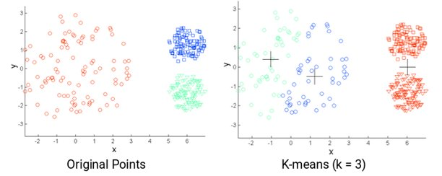
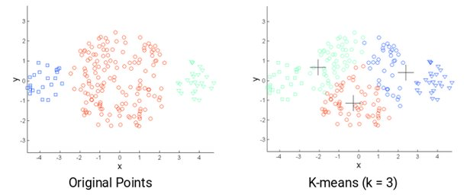
Challenges
Not Clustered
Clustered
Size and density of clusters
Shape of clusters
Randomised initial centroids
Notes:
As with any model, there’s quite a few challenges with K-means as well. ​
From the above figures you can see that there’s noticeable difference between the original points – what logical clusters may seem like, and the cluster results that k means may give. This is because of the size and density of data points. K-means is insensitive to differing cluster density. So, it will most likely split the points into three equal-volume clusters. And as a result, the clusters produced may not have much meaning. ​

Slide 10
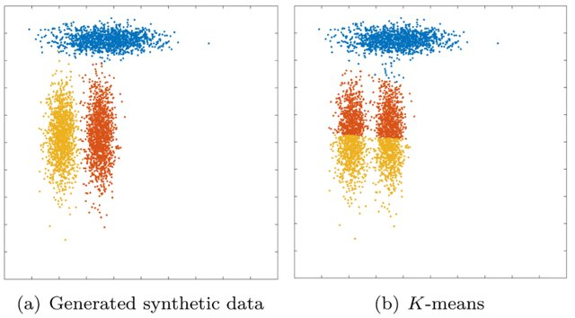
Challenges
Size and density of clusters
Shape of clusters
Randomised initial centroids
Notes:
No intuition of shape. (difficult to draw a line which separates the red and yellow without cutting into the blue above). 3 equal clusters on the right but inferences may not make much sense
K - means assumes spherical shapes of clusters (with radius equal to the distance between the centroid and the furthest data point) and doesn't work well when clusters are in different shapes such as elliptical clusters​

Slide 11
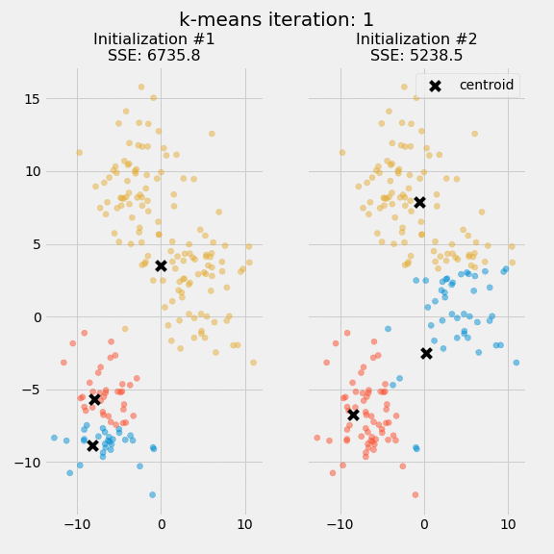
Challenges
Size and density of clusters
Shape of clusters
Randomised initial centroids (Non-Deterministic)
Notes:
Another challenge is that k-means does not guarantee unique clustering. We know that the initial centroids are assigned randomly. With each choice of initial cluster, there may be different clustering results. This becomes a problem and it’s usually advised that you run the algorithm multiple times before drawing any inferences on different clusters. ​

Slide 12
DBSCAN . Density-Based Spatial Clustering of Applications with Noise

Slide 13
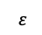
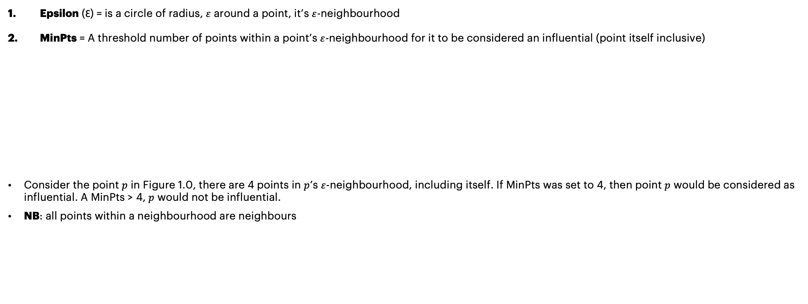
DBSCAN(Epsilon, MinPts)
DBSCAN has 2 main parameters…
Epsilon (Ɛ) = is a circle of radius, $ε$ around a point, it’s $ε$-neighbourhood
MinPts = A threshold number of points within a point’s $ε$-neighbourhood for it to be considered an influential (point itself inclusive)
Consider the point $p$ in Figure 1.0, there are 4 points in $p$’s $ε$-neighbourhood, including itself. If MinPts was set to 4, then point $p$ would be considered as influential. A MinPts > 4, $p$ would not be influential.
NB: all points within a neighbourhood are neighbours
p
$ε$
Figure 1.0

Slide 14
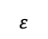
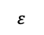
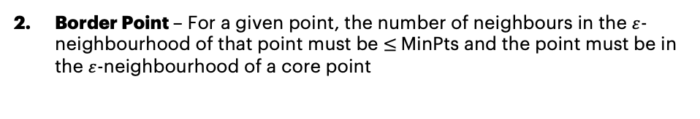
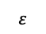
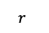
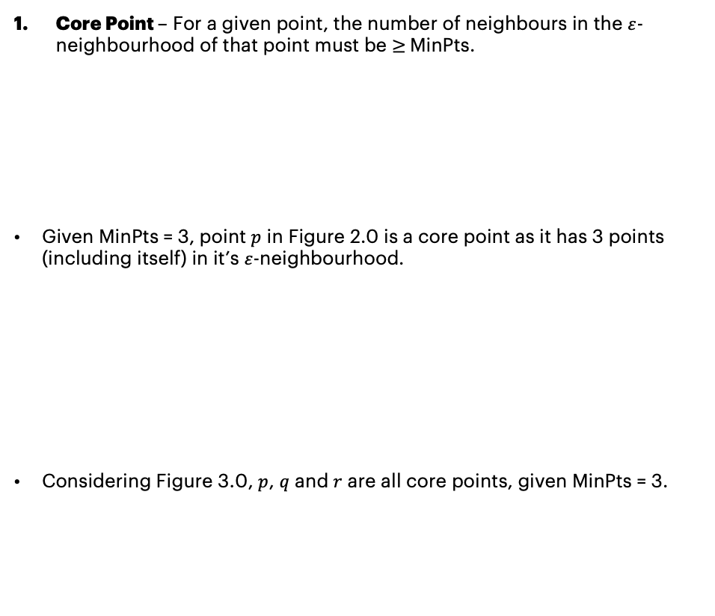
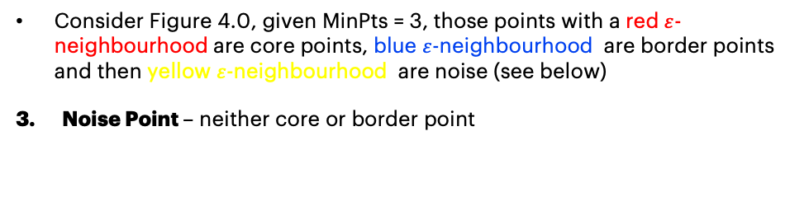
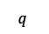
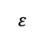
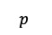
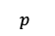
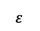
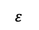
DBSCAN exhaustively classifies each data point into 3 categories…
Core Point – For a given point, the number of neighbours in the $ε$-neighbourhood of that point must be $≥$MinPts.
Given MinPts = 3, point $p$ in Figure 2.0 is a core point as it has 3 points (including itself) in it’s $ε$-neighbourhood.
Considering Figure 3.0, $p$, $q$ and $r$ are all core points, given MinPts = 3.
Border Point – For a given point, the number of neighbours in the $ε$-neighbourhood of that point must be $≤$MinPts and the point must be in the $ε$-neighbourhood of a core point
$ε$
$ε$
$p$
Figure 2.0
$ε$
Figure 4.0
$ε$
$q$
$ε$
Figure 3.0
$ε$
$ε$
$r$
$p$
Consider Figure 4.0, given MinPts = 3, those points with a red $ε$-neighbourhood are core points, blue $ε$-neighbourhood are border points and then yellow $ε$-neighbourhood are noise (see below)
Noise Point – neither core or border point

Slide 15
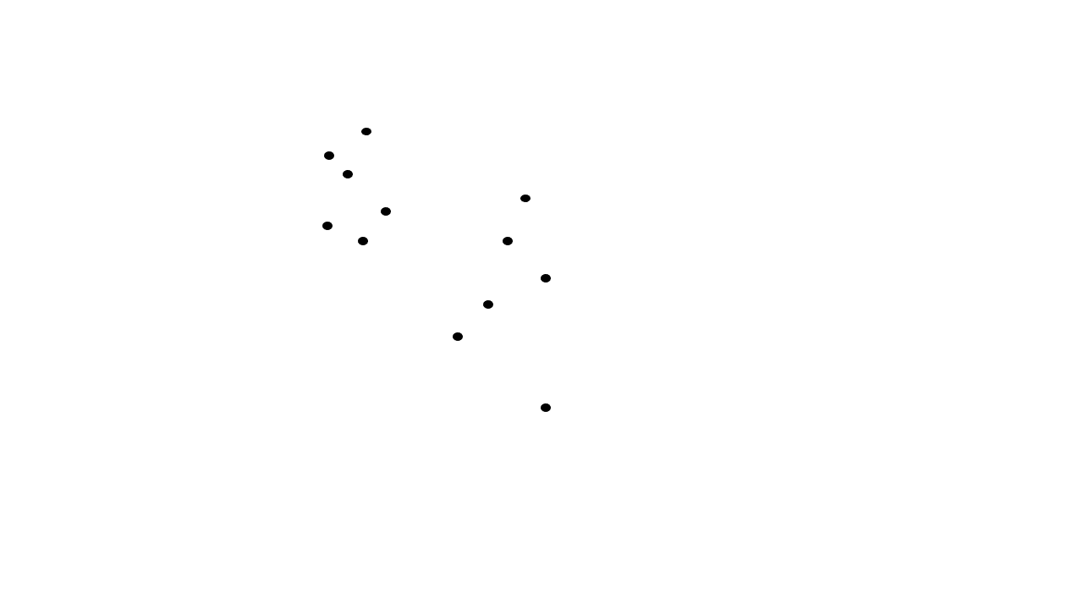
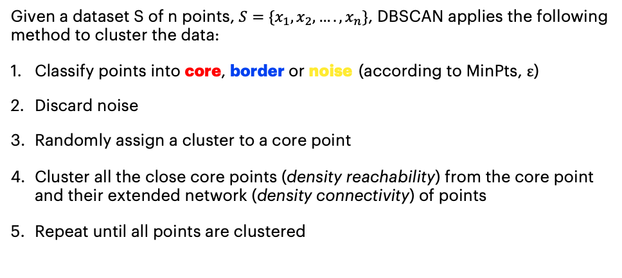
DBSCAN (Epsilon, MinPts)
Objective
Given a set of data points in n-dimensional space, DBSCAN recognises data points in higher density regions as similar and data points in sparce regions as noise /outliers. It forms clusters by connecting data points in close proximity to each other.
Method
Given a dataset S of n points, $S=\{x_{1},x_{2}, ….,x_{n}\}$, DBSCAN applies the following method to cluster the data:
Classify points into core, border or noise (according to MinPts, $ε$)
Discard noise
Randomly assign a cluster to a core point
Cluster all the close core points (density reachability) from the core point and their extended network (density connectivity) of points
Repeat until all points are clustered

Slide 16
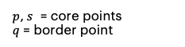
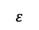
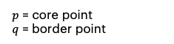
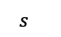
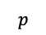
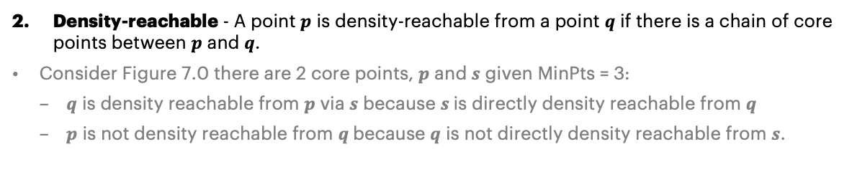
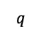
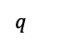
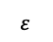
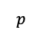
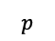
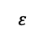
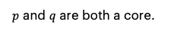
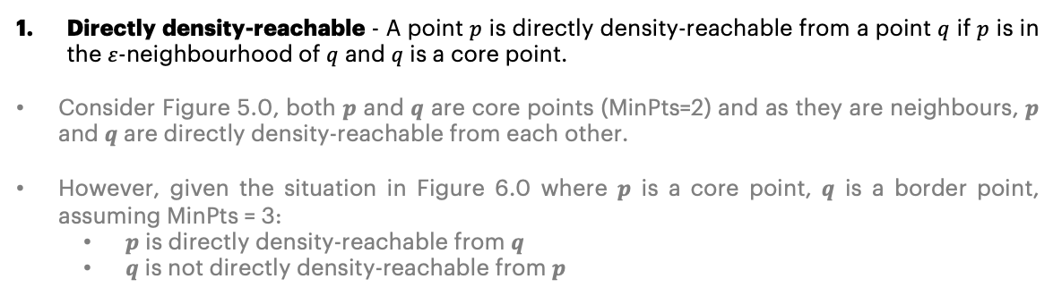
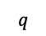
DBSCAN clusters data using 3 key concepts…
$p$ and $q$ are both a core.
$ε$
$q$
Directly density-reachable - A point $p$ is directly density-reachable from a point $q$ if $p$ is in the $ε$-neighbourhood of $q$ and $q$ is a core point.
Consider Figure 5.0, both $p$ and $q$ are core points (MinPts=2) and as they are neighbours, $p$ and $q$ are directly density-reachable from each other.
However, given the situation in Figure 6.0 where $p$ is a core point, $q$ is a border point, assuming MinPts = 3:
$p$ is directly density-reachable from $q$
$q$ is not directly density-reachable from $p$
MinPts = 2
$ε$
$p$
Figure 5.0
$p$ = core point
$q$ = border point
$ε$
$q$
$ε$
$p$
MinPts = 3
Density-reachable - A point $p$ is density-reachable from a point $q$ if there is a chain of core points between $p$ and $q$.
Consider Figure 7.0 there are 2 core points, $p$ and $s$ given MinPts = 3:
$q$ is density reachable from $p$ via $s$ because $s$is directly density reachable from $q$
$p$ is not density reachable from $q$because $q$ is not directly density reachable from $s$.
Figure 6.0
$p$,$s$ = core points
$q$ = border point
Ɛ
Ɛ
$s$
$q$
MinPts = 3
$p$
Figure 7.0

Slide 17
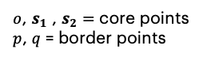
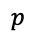
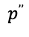
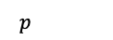
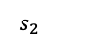
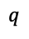
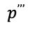












Density connected – A point $p$ is deemed as density connected to another point $q$ according to $ε$ and MinPts in a dataset, if there exists a data point $o$ such that both $p$and $q$ are density-reachable from $o$for a given value of $ε$ and MinPts.
Considering Figure 8.0, we have 3 core points when MinPts = 4: ($o$, $s_{1}$ , $s_{2}$ )
Point $p$ is density connected to point q by the core point o via $s_{1}$ and $s_{2}$ as $o$ is density reachable by both $p$ and $q$.
$o$, $s_{1}$ , $s_{2}=$ core points
$p$, $q$ = border points
MinPts = 4
$q$
Ɛ
$s_{1}$
$o$
Ɛ
$s_{2}$
$p$
$$p$$
$$q$$
$$p$$
d($p$, $q$)
d($p$, $q$)
$$q$$
$$p’$$
$$p’’’’$$
Figure 8.0
$$p’’$$
$$p’’’$$
p and q are core points
d(p, q) $≤$ $ε$
All points are core points
d(p, q) > $ε$
d($p$, $p’$), d($p’$, $p’’$), d($p’’$, $p’’’$), d($p’’’$, $p’’’’$), d($p’’’’$, $q$) $≤$ $ε$

Slide 18

Challenges
Selecting MinPts and $ε$ can require an SME input. The DBSCAN paper suggests MinPts $≥$ n-dimensions + 2
DBSCAN(Epsilon, MinPts) is very sensitive to eps
MinPts = 5

Slide 19
Clustering Simulations
K-Means
https://www.naftaliharris.com/blog/visualizing-k-means-clustering/
DBSCAN
https://www.naftaliharris.com/blog/visualizing-dbscan-clustering/

Slide 20
Performance Metrics

Slide 21




















Silhouette Coefficient, S_{s}
B
The Silhouette Coefficient, $S_{s}$measures the separation between clusters. It calculates how close each point in a cluster is to points in the nearest neighbouring cluster, assigning $S_{s}$= 1 for well separated clusters, $S_{s}$= 0 for indifferent clusters that have insignificant distances between them and $S_{s}$= -1 for incorrectly assigned clusters.
The mean Silhouette Coefficient for a clustered dataset of $n$ data points is given by,
A
$$d_{A_{i} ,{ B}_{3}}$$
$$d_{A_{i} ,{ B}_{2}}$$
$$d_{A_{i} ,{ A}_{2}}$$
$$S_{s}= \frac{1}{n}\sum_{i=1}^{n}{S_{s_{i}} }= \frac{1}{n}\sum_{i=1}^{n}{\frac{b_{i}−a_{i}}{max⁡(a_{i}, { b}_{i})}}$$
$$d_{A_{i} ,{ B}_{1}}$$
$$−1≤ S_{s}≤1$$
$$d_{A_{i} ,{ A}_{1}}$$
Where,
a = average intra-cluster distance i.e. the average distance between each point within a cluster
b = average inter-cluster distance i.e. the average distance between all clusters.
Considering the data point, A_{i} in the left diagram,
A_{i}
$$d_{A_{i} ,{ C}_{2}}$$
$$d_{A_{i} ,{ C}_{1}}$$
C
$a_{i}=\frac{1}{n_{A}}\sum_{i}^{n_{A}}{d_{A_{i} ,{ A}_{j}}} =\frac{1}{2}(d_{A_{i} ,{ A}_{1}}+d_{A_{i} ,{ A}_{2}}$)
$$b_{i}=\min\left\{\frac{1}{n_{k}}\sum_{i}^{n_{k}}{d_{A_{i} ,{ K}_{j } }, …, }\right\}for k=B, C$$
,
C = 2
C = 3
C = 4
C = 10
Higher = better
$S_{s}$ = 0.8426485557985274
$S_{s}$ = 0.5724658484472722
$S_{s}$ = 0.31545152195224646
$S_{s}$ = 0.31823839261955933

Slide 22











Calinski-Harabasz Score, S_{CH}
For a set of data E of size $n_{E}$ which has been clustered into k clusters, the Calinski-Harabasz score $S_{CH}$ is defined as the ratio of the between-clusters dispersion and the within-cluster dispersion.
$$S_{CH}= \frac{tr(B_{k})}{tr(W_{k})}×\frac{n_{E}−k }{k −1 }$$
$$0≤ S_{CH}$$
Where $tr(B_{k})$ and $tr\left(W_{k}\right)$ are the traces of the between-cluster dispersion and within-cluster dispersion matrices respectively, defined by:
$$W_{k}=\sum_{q=1}^{k}{\sum_{x∈C_{q}}{(x−c_{q}){(x−c_{q})}^{T}}}$$
$$B_{k}= \sum_{q=1}^{k}{n_{q}(c_{q}−c_{E}){(c_{q}−c_{E})}^{T}}$$
$$\left[\begin{matrix}A_{1,1} & A_{1, 2} & A_{1,3} \\ A_{2,1} & A_{2,2} & A_{2,3} \\ A_{3,1} & A_{3,2} & A_{3,3}\end{matrix}\right]$$
,
$$tr\left(A\right)=$$
Where $C_{q}$ is the set of points in cluster q, $x$ is the point in set $C_{q}$, $c_{q}$is the centroid of cluster q, $c_{E}$is the centroid of the data E and $n_{q}$ is the number of points in cluster q.
C = 2
C = 3
C = 4
C = 10
Higher = better
$S_{CH}$ = 31769.671266965586
$S_{CH}$ = 19268.60197885731
$S_{CH}$ = 16217.76795330653
$S_{CH}$ = 12440.531456663053

Slide 23
A Note on Clustering Metrics
Internal clustering metrics such as Silhouette Coefficient and Calinski-Harabasz Score are heuristic devices. They should be used to compare clustering solutions obtained on the same data, with optimum clustering parameters chosen on the best performing configuration.
Clustering metrics can either require or not require ground truth labels. The Silhouette Coefficient and Calinski-Harabasz Score are internal clustering validation techniques and thus do not require any ground truth labels. External clustering validation methods such as Rand Index do require ground truth labels.
The Silhouette Coefficient and Calinski-Harabasz Score are generally higher for algorithms that cluster convex sets (spherical data) such as partitioning algorithms like K-Means over density based approaches like DBSCAN that can cluster arbitrary shapes.

Slide 24

Ultimately, your choice of clustering algorithm depends on the data and the end goal…
DBSCAN
K-Means
Data is arbitrarily shaped
Data is known to have outliers i.e. sensor timeseries (instrument failures)
Your solution needs to be deterministic
Data is known to be approximately convex / spherical
Data is apparently clean i.e. KYC data
Your solution doesn’t require a high degree of domain knowledge
You want to implement a quick, easy and interpretable solution to gain some insights

Slide 25
Live Coding

Slide 26
Appendix

Slide 27
(1) Additional Reading
K-Means
https://www.youtube.com/watch?v=_aWzGGNrcic&t=374s&ab_channel=VictorLavrenko
https://www.youtube.com/watch?v=4b5d3muPQmA&ab_channel=StatQuestwithJoshStarmer
https://towardsdatascience.com/understanding-k-means-clustering-in-machine-learning-6a6e67336aa1
https://digitalassets.lib.berkeley.edu/math/ucb/text/math_s5_v1_article-17.pdf
https://www.youtube.com/watch?v=LmpkKwsyQj4&t=683s&ab_channel=stanfordonline
DBSCAN
https://www.youtube.com/watch?v=Q7iWANbkFxk&t=596s&ab_channel=NormalizedNerd
https://www.naftaliharris.com/blog/visualizing-dbscan-clustering/
https://www.aaai.org/Papers/KDD/1996/KDD96-037.pdf
https://www.youtube.com/watch?v=RDZUdRSDOok&ab_channel=StatQuestwithJoshStarmer
Metrics
https://odsc.medium.com/assessment-metrics-for-clustering-algorithms-4a902e00d92d
https://towardsdatascience.com/performance-metrics-in-machine-learning-part-3-clustering-d69550662dc6
https://medium.com/@haataa/how-to-measure-clustering-performances-when-there-are-no-ground-truth-db027e9a871c

Slide 28



(2) Auto-Selecting Epsilon, $ε$
The point of maximum curvature on the elbow represents the value for ε that maximises the cluster size whilst minimising the number of outliers.
MinPts = 3
K^{th}= MinPts + 1= 4
(first distance is to the point itself)
$$ε$$
4th
3rd
2nd
K^{th} Nearest Neighbours

Slide 29


(3) Types of Clustering
Partitional Clustering
It is used to classify observations within a dataset into multiple groups based on their similarities and dissimilarities. These algorithms minimise a given clustering criterion by repeatedly relocating data points between clusters until a (locally) optimal partition is attained.
Examples: K-Means, PAM(k-Medoid), CLARA algorithm (Clustering Large Applications) etc.
Hierarchical Clustering
Each item within a dataset starts as an individual cluster, or singleton. The algorithm computes the proximity amongst each cluster and then proceeds to merge each pair of closest clusters and computes the new proximity amongst remaining clusters. This process is then repeated until there is one cluster left. The clusters depend on which level the dendrogram is cut.
Examples: DBSCAN, HDBSCAN and OPTICS.
Notes:
CHANGE EXAMPLES – EX: ANIMALS
Partitional or Flat Clustering –

